Slide 1
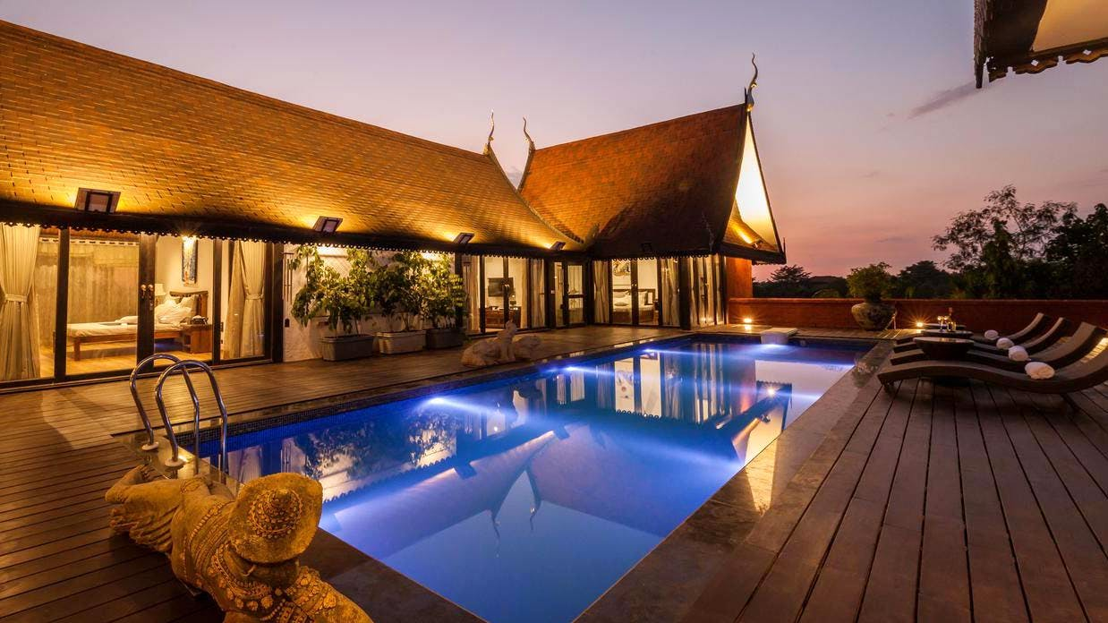
INTERNET AND WEB PROGRAMMING
HOME STAY FOR TOURISTS

Slide 2
TEAM MEMBERS:
KARUTURI SURYA VENKATA RAGHURAM – 19BCE0160
SADU VENKATA SAI JIGNESH – 19BCE0038
BOLINENI GANESH SAI – 19BCE0199
MEESALA LOHITH KUMAR – 19BCE0098
SAMUDRALA VENKATA MARUTHI – 19BCE0128

Slide 3
ABSTRACT
Homestay is the alternative accommodation facilities available in tourism destinations. Homestay is familiar at global level. In India, people prefer to travel and explore the all kinds of destinations homestay is becoming a more of preferred accommodation. The major reason to choose homestay accommodation by the tourists is enjoy the fresh air, greenery and ambience of home, to taste the traditional food, understand the culture of the destination and cost of food and accommodation.

Slide 4
PROBLEM STATEMENT
We are looking for lower and better accommodation due to the increase of travelers, homestay provide for these needs with convenient services. In the previous papers they hadn’t initialized the option to select which type of homestay they need like hill view homestay , evergreen home stay, beach view homestay etc ,and also feed back of customers and check in and check out time. In our project we will try to include these facilities.

Slide 5
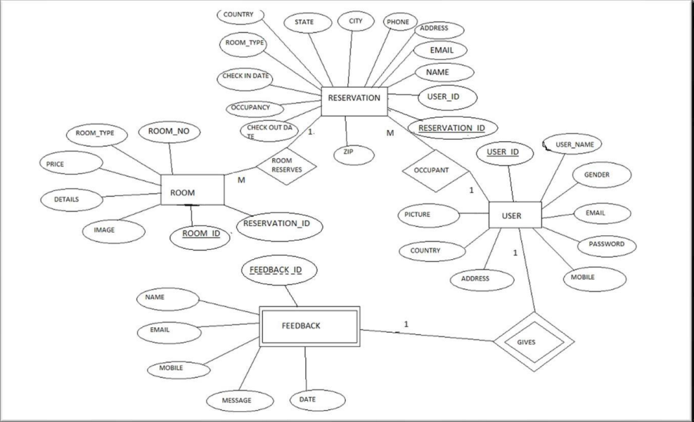
BLOCK DIAGRAM

Slide 6
THANK YOU

